Slide 1
Azure IoT Adafruit Feather Huzzah ESP8266 Starter Kit Getting Started TutoriaL
Whew! That’s a mouth full!

Slide 2
Agenda

Slide 3
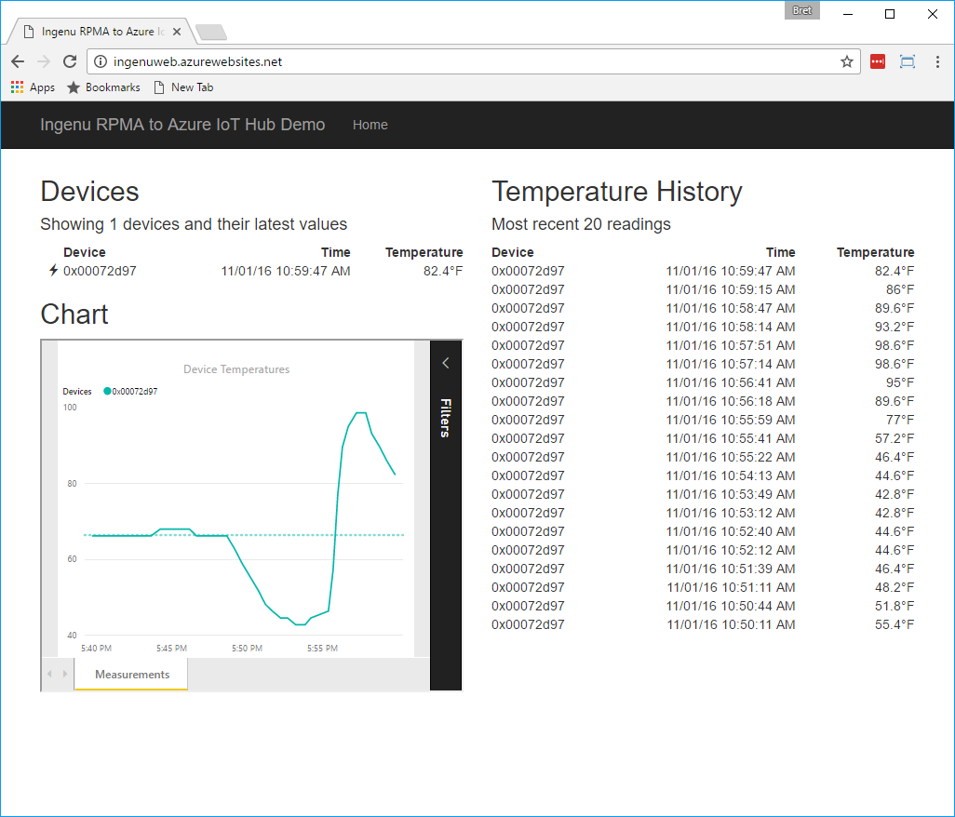
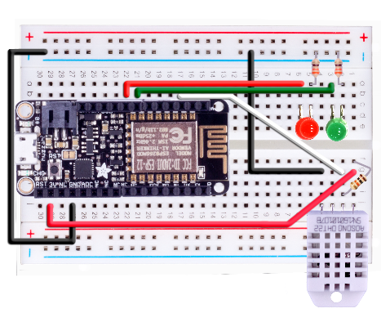
Resource Group <name>group
App Service Plan <name>plan
GET
Web App <name>web
QUERY
RECEIVE
Storage Account <name>storage
Service Bus Namespace <name>bus
Table
SensorData
Event Hub
<name>eventhub
OUTPUT
OUTPUT
Stream Analytics Job <name>asajob
SEND
INPUT
IoT Hub <name>iothub
AZURE
Device Identity
<name>huzzah
Solution Architecture
DEVICE-TO-CLOUD
CLOUD-TO-DEVICE
Huzzah Device
Connects as: <name>huzzah
Communication can be over: AMQPS MQTTS
or
HTTPS
DEVICE

Slide 4
Resource Group <name>group
App Service Plan ingenuplan
Function App <name>functions
GET
Web App <name>web
Function SendDeviceAlerts
Function SendDevicePing
QUERY
Service Bus Namespace <name>bus
Storage Account <name>storage
RECEIVE
Table
SensorData
Event Hub
<name>alerts
OUTPUT
OUTPUT
Stream Analytics Job <name>asajob
Send Cloud to Device Msg Via Hub
INPUT
IoT Hub <name>iothub
AZURE
Device Identity
<name>huzzah
Solution Architecture
Device to Cloud
Cloud to Device
DEVICE
ESP8266 Device <name>huzzah

Slide 5




Slide 6
IoT Logo

Slide 7
arduino

Slide 8
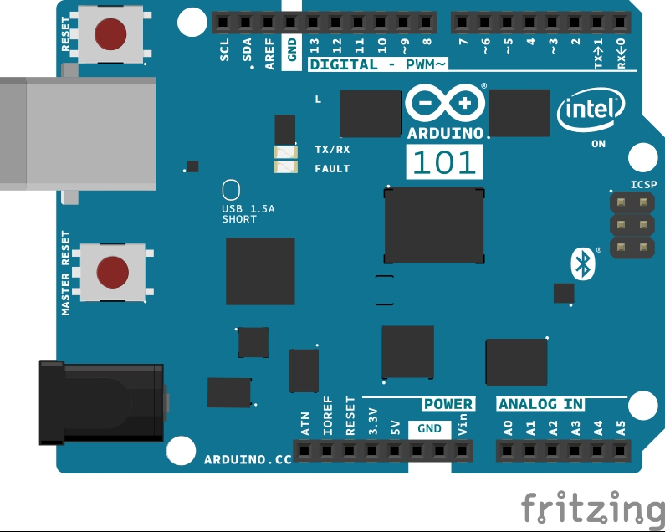
Arduino 101

Slide 9
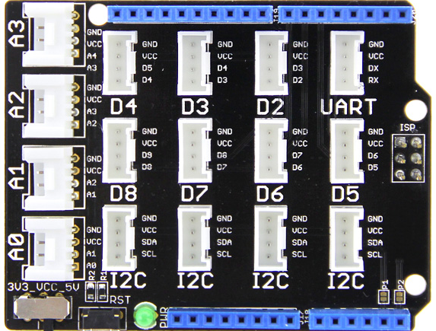
Grove Base Shield

Slide 10
Grove cable & SENSORS

Slide 11
Grove cable & SENSORS

Slide 12
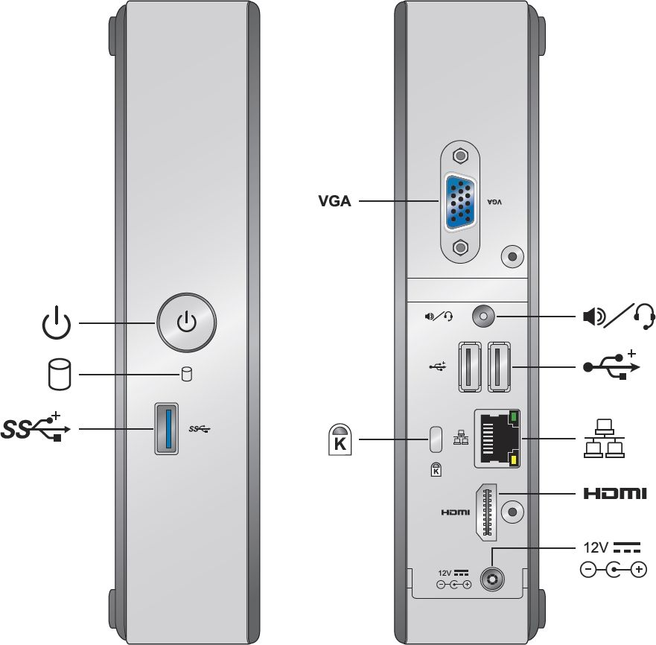
INTEL NUC DE3815TYKE

Slide 13
GALILEO BOARD

Slide 14
RASPBERRY PI

Slide 15
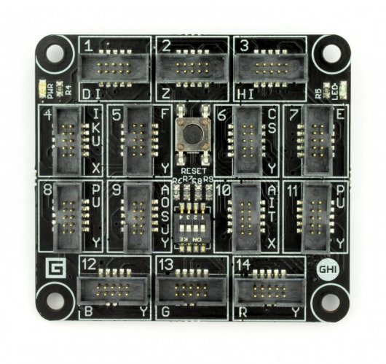
FEZ SPIDER MAIN BOARD

Slide 16
Sparkfun weather shield

Slide 17
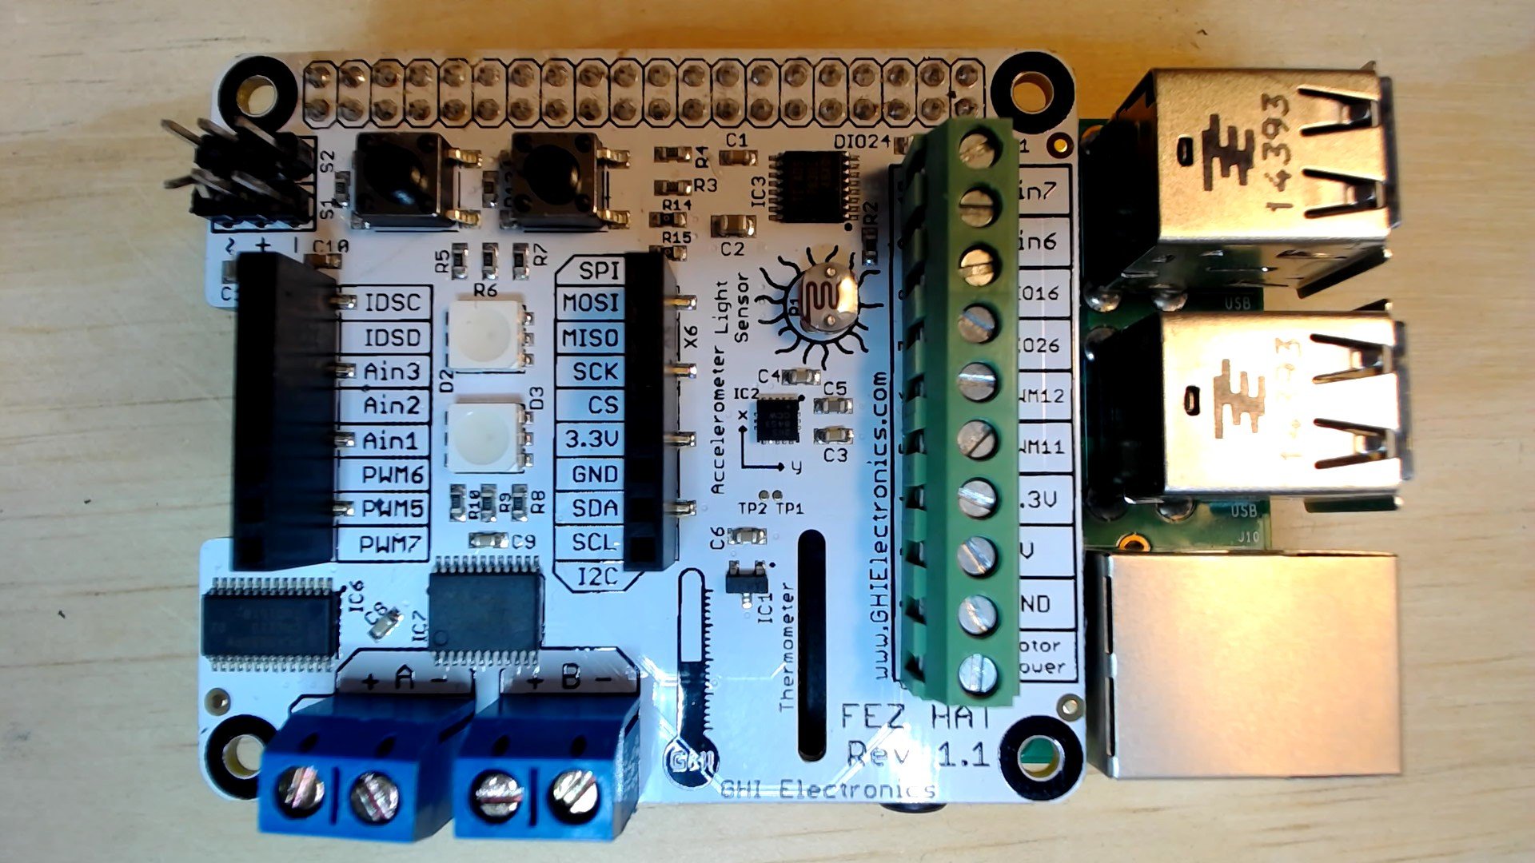
FEZ HAT

Slide 18
Connect the dots azure icons
Event Hubs
Stream Analytics
Storage
(
Azure
Microsoft Azure
Web App
Service Bus
)
Storage blob
Storage table
SQL database
HDInsight
Machine
(
Learning
GitHub code
Git repository
generic
)

Slide 19
LEDs

Slide 20
Resistors
220Ω
1st Digit
2nd Digit
Multiplier
Tolerance
Color | Name | 1st Digit | 2nd Digit | Multiplier | Tolerance
 | Black | 0 | 0 | X1
 | Brown | 1 | 1 | X10 | 1%
 | Red | 2 | 2 | X100
 | Orange | 3 | 3 | X1,000
 | Yellow | 4 | 4 | X10,000
 | Green | 5 | 5 | X100,000
 | Blue | 6 | 6 | X1,000,000
 | Violet | 7 | 7
 | Grey | 8 | 8
 | White | 9 | 9
 | Gold |  |  | X0.1 | 5%
 | Silver |  |  | X0.01 | 10%
330Ω
10KΩ

Slide 21
cables

Slide 22
More cables and adapters

Slide 23

LEDs
Anode (+)
Cathode (-)
Flat Edge
Small Post
Big Post
Long Leg
Short Leg
Vcc (+)
GND

Slide 24
LEDs

Slide 25
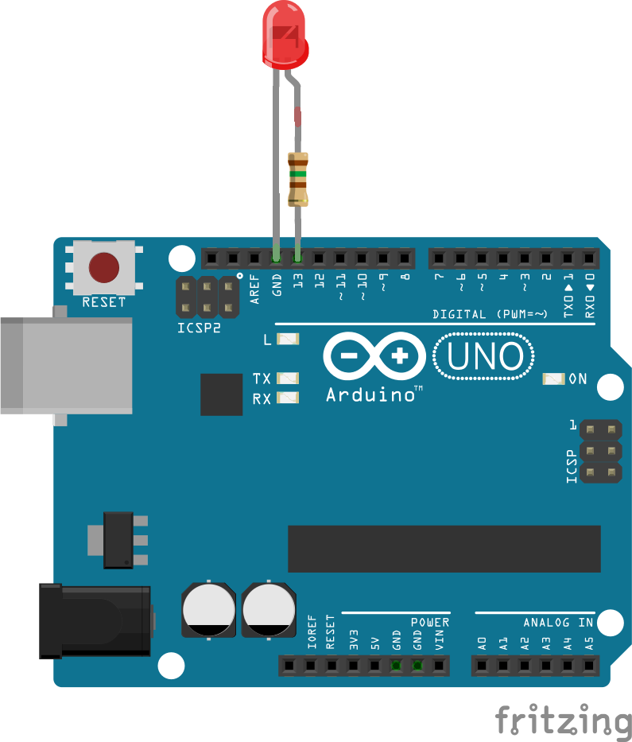

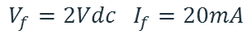
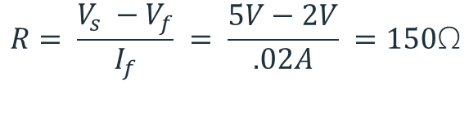
Current limiting resistors
Providing more current than an LED is rated for can destroy the LED. To prevent that, you should use a “Current Limiting” resistor.
To calculate the value of the resistor you need to know the supply voltage (Usually 5V on the Arduino Uno), and the LEDs rated Forward Voltage (the voltage drop across the LED) and Forward Current (the maximum current the LED can handle).
$$V_{f}=2Vdc I_{f}=20mA$$
$$Resistor Value (R)= \frac{Supply Voltage \left(V_{s}\right)−LED Forward Voltage (V_{f}) }{LED Forward Current (I_{f})}$$
$$V_{s}=5Vdc$$
$$R= \frac{V_{s} −V_{f}}{I_{f}} = \frac{5V−2V}{.02A} =150\text{Ω}$$
The Arduino Uno has a built in current limiting resistor on Pin 13. If you use Pin 13 to power your LED you can use it without a separate resistor.

Slide 26
Resistors
220Ω
1st Digit
2nd Digit
Multiplier
Tolerance
Color | Name | 1st Digit | 2nd Digit | Multiplier | Tolerance
 | Black | 0 | 0 | X1
 | Brown | 1 | 1 | X10 | 1%
 | Red | 2 | 2 | X100
 | Orange | 3 | 3 | X1,000
 | Yellow | 4 | 4 | X10,000
 | Green | 5 | 5 | X100,000
 | Blue | 6 | 6 | X1,000,000
 | Violet | 7 | 7
 | Grey | 8 | 8
 | White | 9 | 9
 | Gold |  |  | X0.1 | 5%
 | Silver |  |  | X0.01 | 10%
330Ω
10KΩ

Slide 27
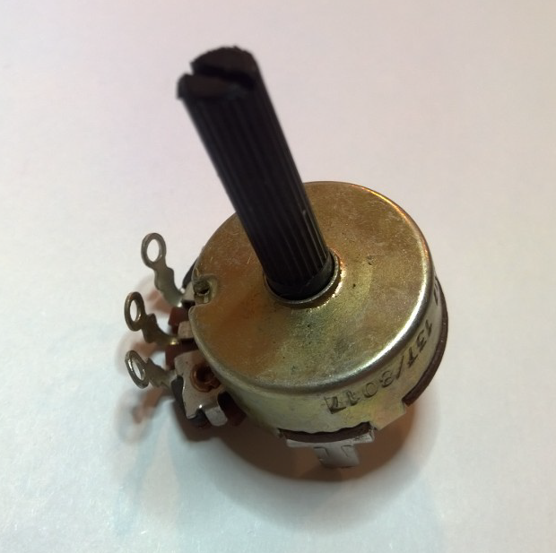
Potentiometer – variable resistor

Slide 28
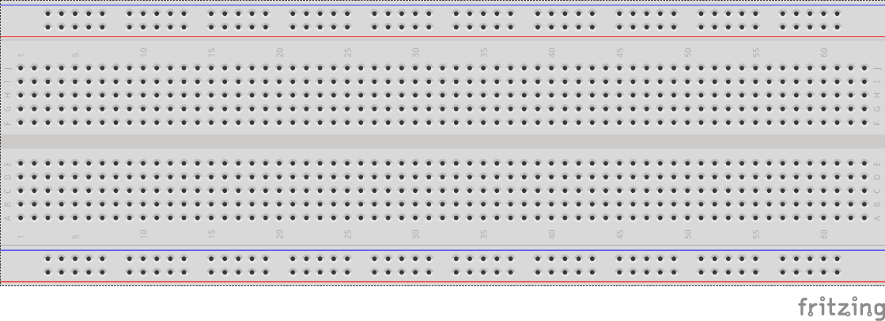
breadboards
Breadboards offer a great way to prototype circuits. The provide a number of “buses” for connecting both power and components.
Power buses run the entire horizontal length
Component buses give you easy ways to connect pins together

Slide 31
Micro SD Cards
Font: Segoe UI Semibold

